Slide 1

Computational Thinking
Chapter 7

Slide 2
What is Computational Thinking
Computational thinking allows us to take a complex problem, understand what the problem is and develop possible solutions.
The term computational thinking was popularized by Professor Jeannette Wing. Wing defined computational thinking as “the thought processes involved in formulating problems and their solutions so that the solutions are represented in a form that can be effectively carried out by an information processing agent”

Slide 3
Computational Thinking
Computational thinking involves four key techniques or “pillars”:
Pattern Matching – identifying patterns and recognizing when two patterns are similar
Abstraction – ignoring irrelevant details and reducing a problem to its essential features
Decomposition – Breaking a complex problem down into smaller and more simpler tasks and then solving each one individually
Algorithms – using a sequence of steps to solved a problem

Slide 4
Computational Thinking
A complex problem is one that, at first glance, we don't know how to solve easily.
Computational thinking involves taking that complex problem and breaking it down into a series of small, more manageable problems (decomposition). Each of these smaller problems can then be looked at individually, considering how similar problems have been solved previously (pattern recognition) and focusing only on the important details, while ignoring irrelevant information (abstraction). Next, simple steps or rules to solve each of the smaller problems can be designed (algorithms).
Finally, the algorithms are used to program a computer to help solve the complex problem in the best way

Slide 5
Decomposition
Decomposition is breaking a complex problem down into smaller and more simpler tasks and then solving each one individually.
It is a way of thinking about artefacts in terms of their component parts.

Slide 6
Decomposition
For example, making breakfast can be broken down, or decomposed, into separate activities such as make toast; make tea; boil egg; etc. Each of these, in turn, might also be broken down into a set of steps.
Consider developing a game: different people can design and create the different levels independently, provided that key aspects are agreed in advance. A simple arcade level might also be decomposed into several parts, such as the life-like motion of a character, scrolling the background and setting the rules about how characters interact.

Slide 7
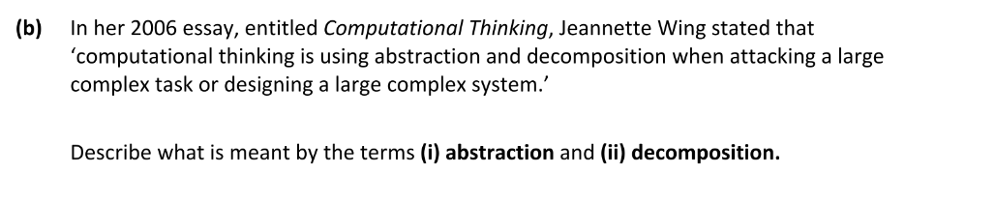
Decomposition (Exam Question Ordinary)

Slide 8
Decomposition (Exam Question Ordinary)

Slide 9
Pattern Matching
identifying patterns, similarities and connections, and exploiting those features. It is a way of quickly solving new problems based on previous solutions to problems.
Asking questions such as “Is this similar to a problem I’ve already solved?” and “How is it different?” are important here, as is the process of recognising patterns both in the data being used and the processes/strategies being used. Algorithms that solve some specific problems can be adapted to solve a whole class of similar problems..

Slide 10
Pattern Matching (Example)
A pupil uses a floor turtle to draw a series of shapes, such as a square and a triangle. The pupil writes a computer program to draw the two shapes. They then want to draw an octagon and a 10-sided shape. From the work with the square and triangle, they spot that there is a relationship between the number of sides in the shape and the angles involved. They can then write an algorithm that expresses this relationship and use it to draw any regular polygon.

Slide 11
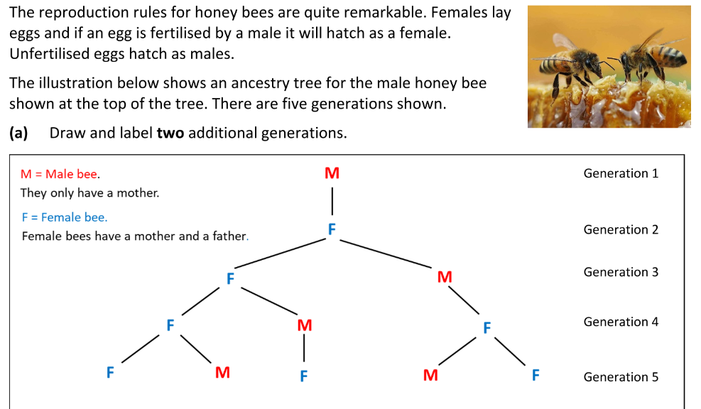
Pattern Matching (Exam Question Higher)

Slide 12
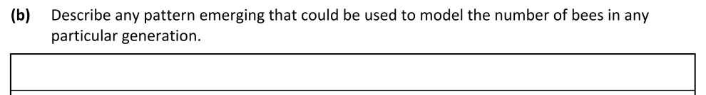
Pattern Matching (Exam Question Higher)

Slide 13
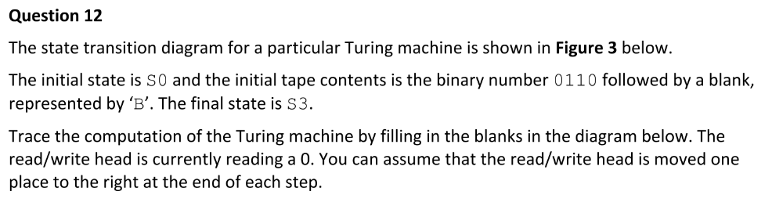
Pattern Matching (Exam Question Higher)

Slide 14
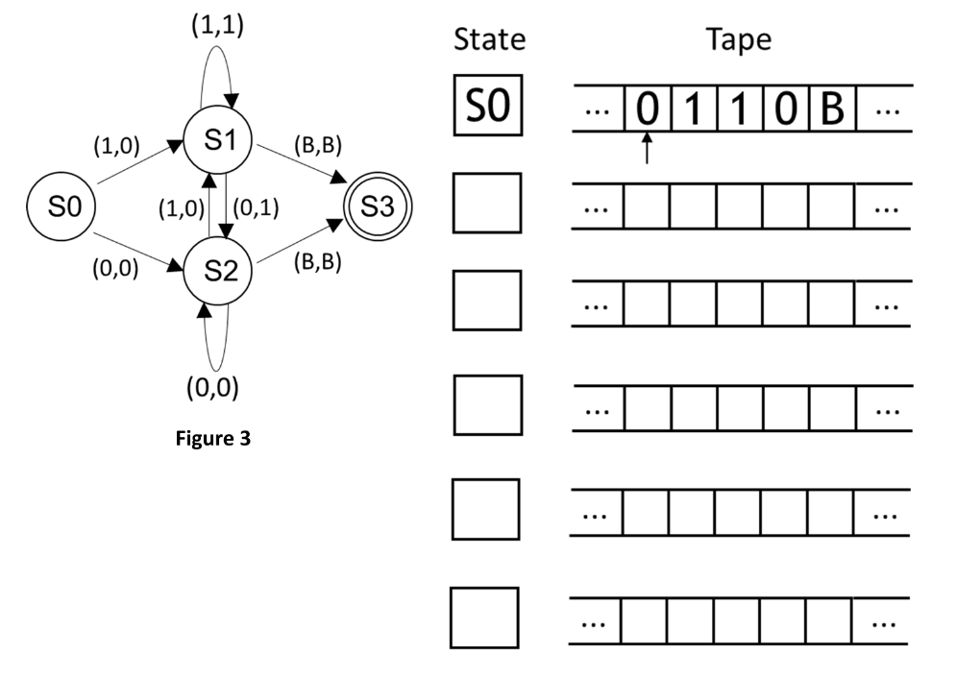
Pattern Matching (Exam Question Higher)

Slide 15
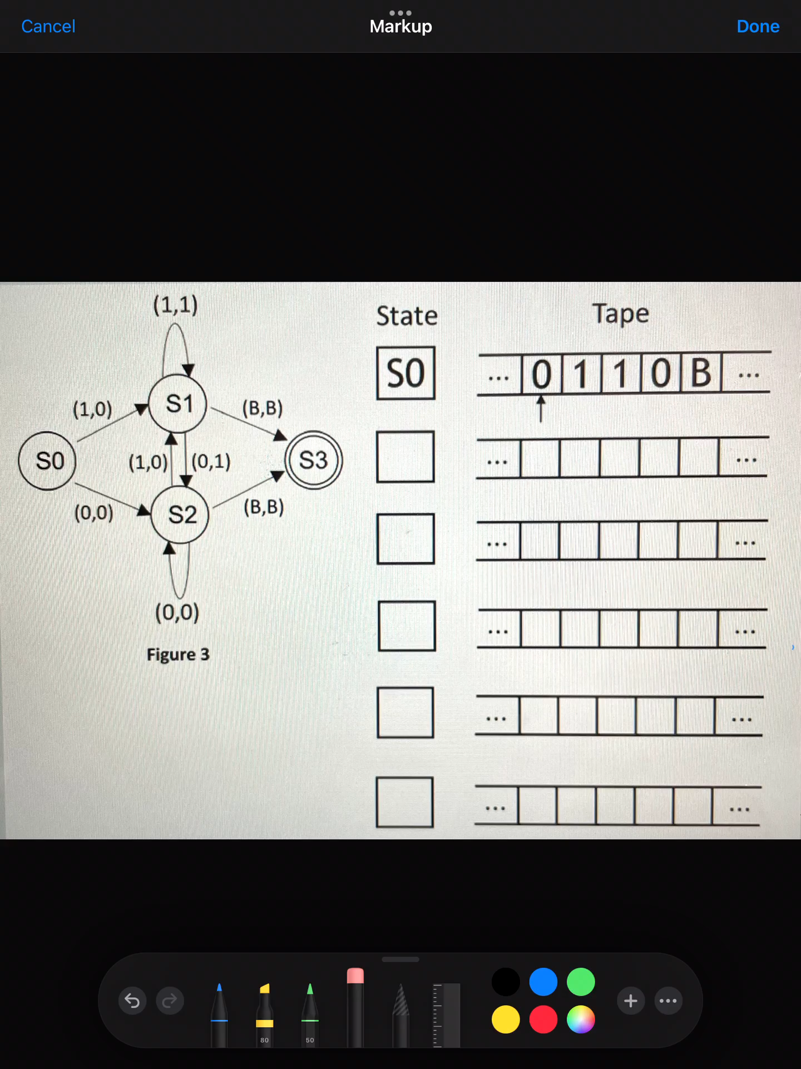
Video for solution to previous question

Slide 16
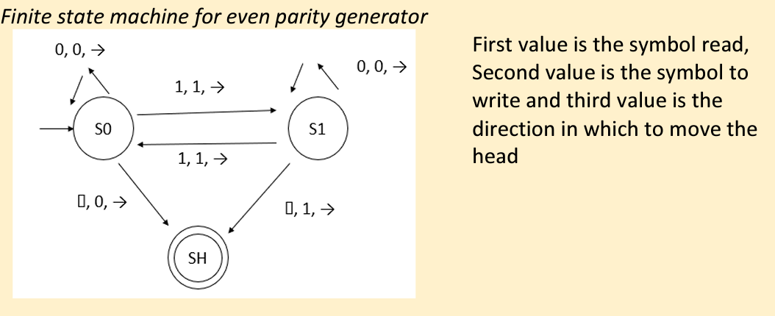
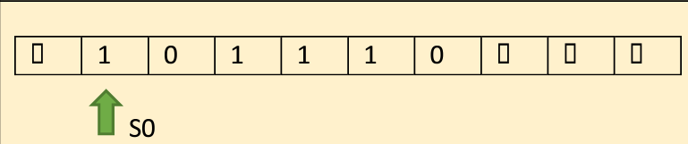
Pattern Matching (Other Example)

Slide 17
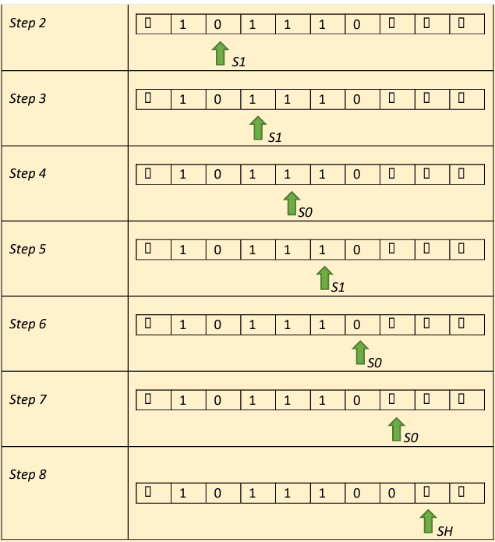
Pattern Matching (Other Example)

Slide 18
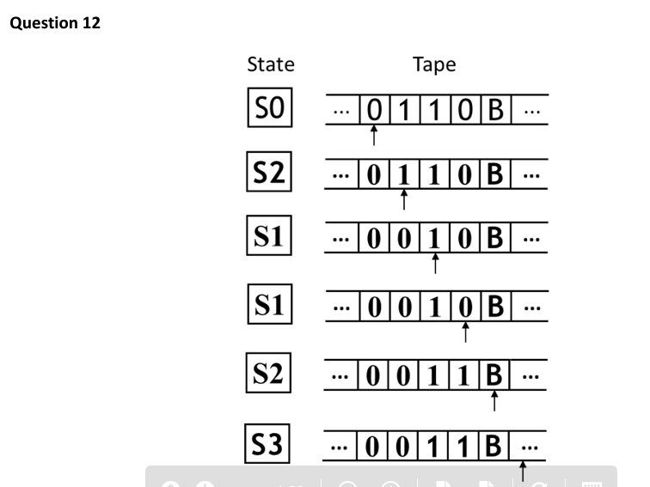
Pattern Matching (Exam Question Higher)

Slide 19
Abstraction
Abstraction – ignoring irrelevant details and reducing a problem to its essential features
https://www.youtube.com/watch?v=jV-7Hy-PF2Q

Slide 20
Abstraction
Abstraction is the process of making an artefact more understandable through reducing the unnecessary detail. A classic example is the London Underground map. London is a highly complex system. The London Underground map is a highly refined abstraction with just sufficient information for the traveller to navigate the underground network without the unnecessary burden of information such as distance and exact geographic position. It is a representation that contains precisely the information necessary to plan a route from one station to another – and no more!

Slide 21
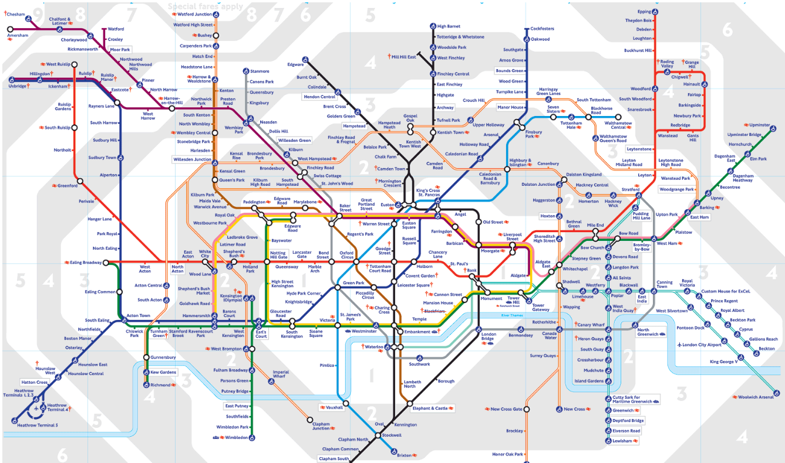
Abstraction

Slide 22
Using Abstraction when designing programs
Defining functions is a very good example of how abstraction can be achieved when designing programs
E.g. the print() function. The programmer knows what it does and how to use it. The program doesn’t need to know the technical details of exactly how the argument you provide the print function ends up on the screen. These details are “abstracted away” by the function

Slide 23
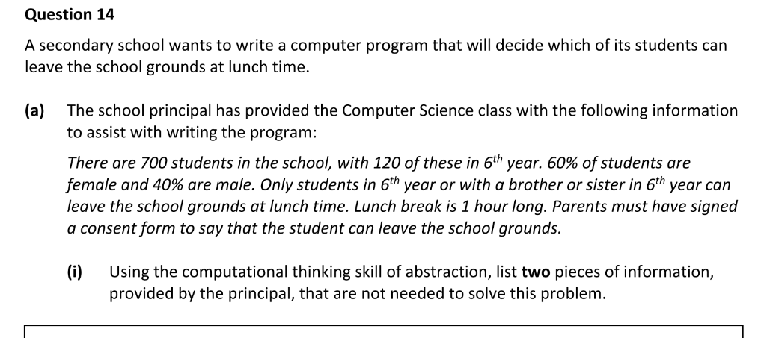
Abstraction – Leaving Cert Questions (Ordinary)

Slide 24
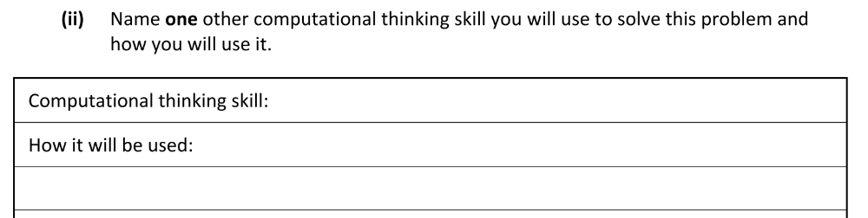
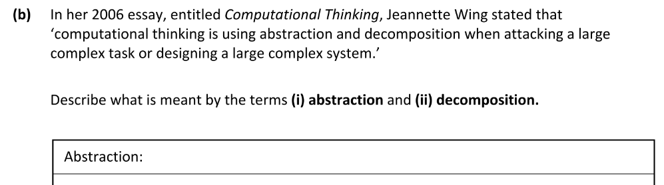
Abstraction – Leaving Cert Questions (Ordinary)

Slide 25
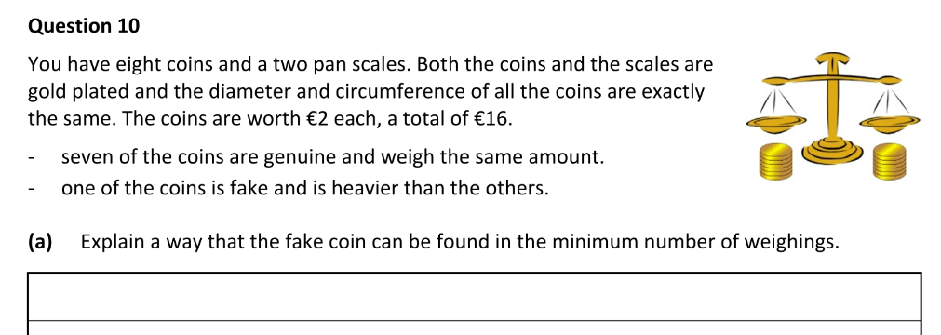

Abstraction – Leaving Cert Questions (Higher)

Slide 26
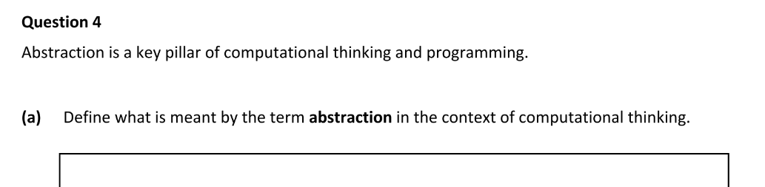
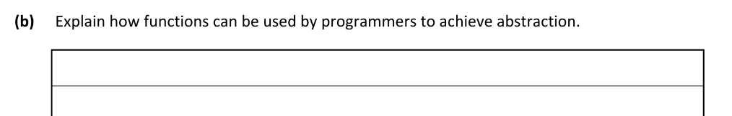
Abstraction – Leaving Cert Questions (Higher)

Slide 27
Algorithms
An algorithm is a sequence of steps required to solve a problem
Abstraction is a key concern when designing a new algorithm. The level of detail required (level of abstraction) depends on the application of the end program. Designing an algorithm for a robot vacuum cleaner to move around a room in a house requires a different level of abstraction to designing an algorithm to ensure that a self-driving car can travel safely on a street

Slide 28
Algorithms
Algorithms for computers must meet the following criteria:
Be specific and clear. Every detail and every possibility must be accounted for because computers can’t guess or rely on previous experience
Consist of a finite number of steps. The algorithm must terminate (no infinite loops)
Have a clear flow of control from beginning to end

Slide 29
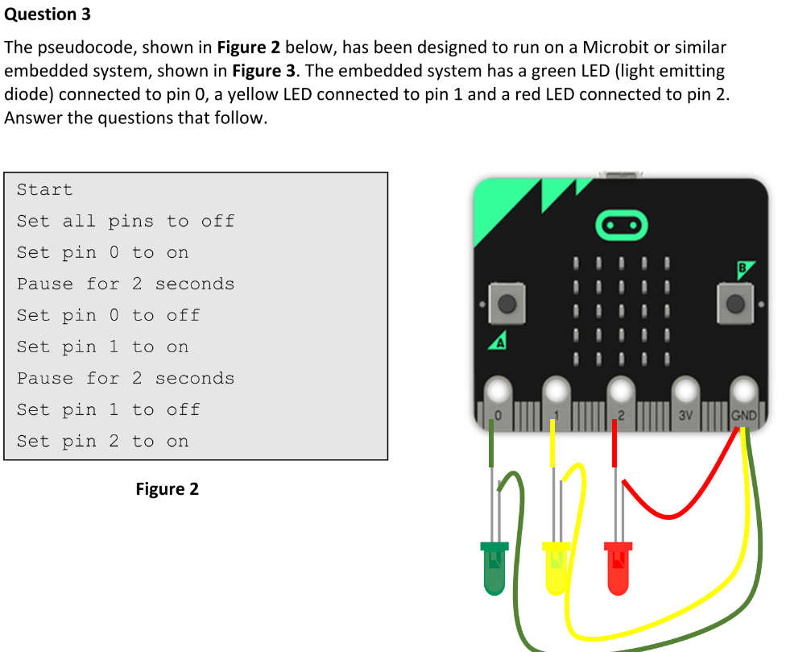
Algorithms – Leaving Cert Questions (Ordinary)

Slide 30
Algorithms – Leaving Cert Questions (Ordinary)

Slide 31
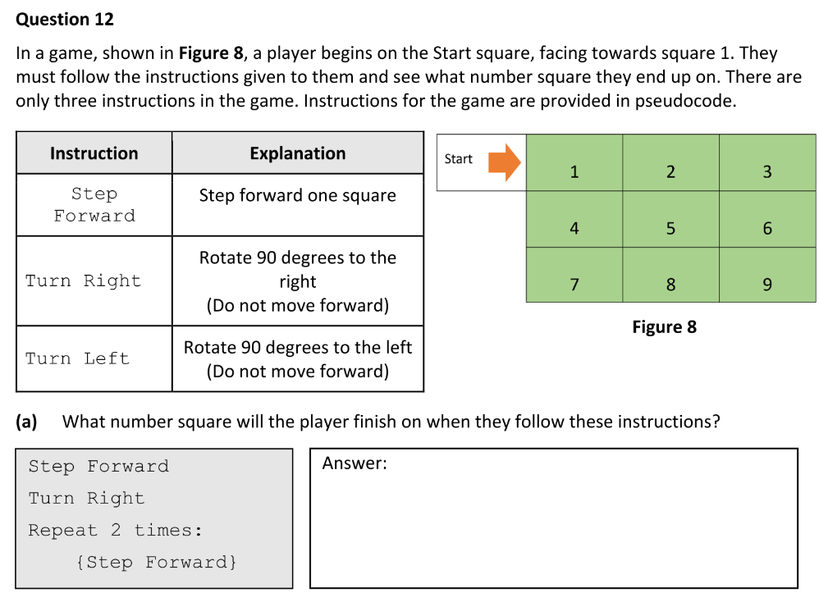
Algorithms – Leaving Cert Questions (Ordinary)

Slide 32
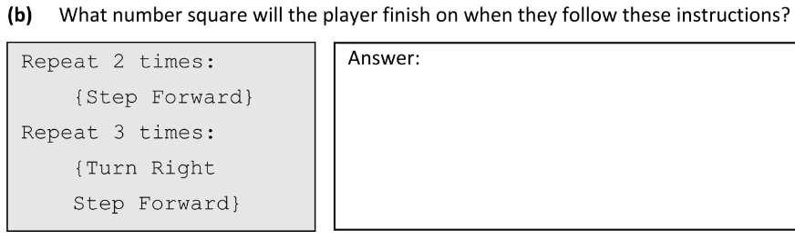
Algorithms – Leaving Cert Questions (Ordinary)

Slide 33
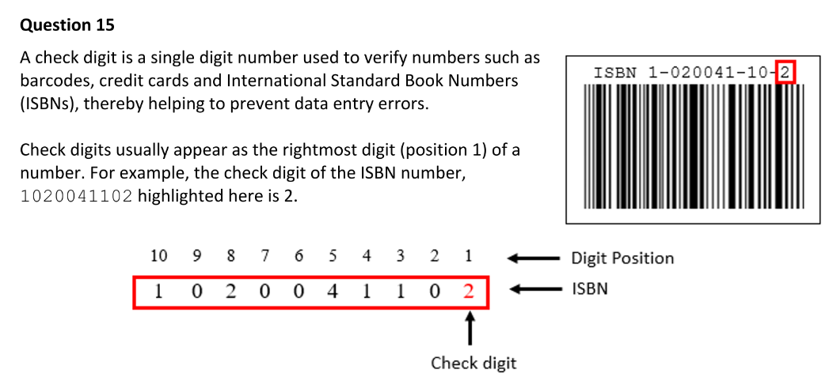
Algorithms – Leaving Cert Questions (Higher)

Slide 34
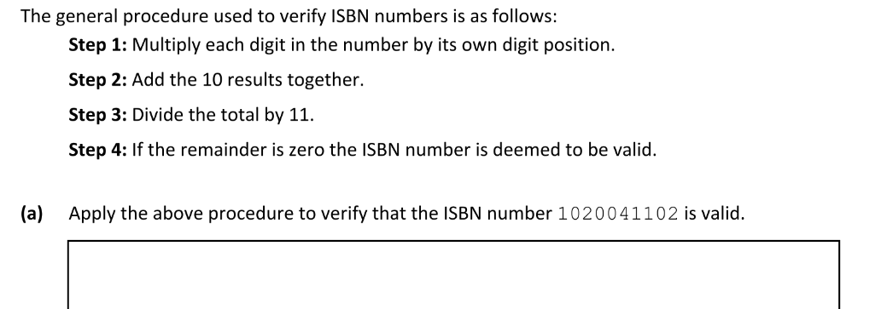
Algorithms – Leaving Cert Questions - Higher

Slide 35
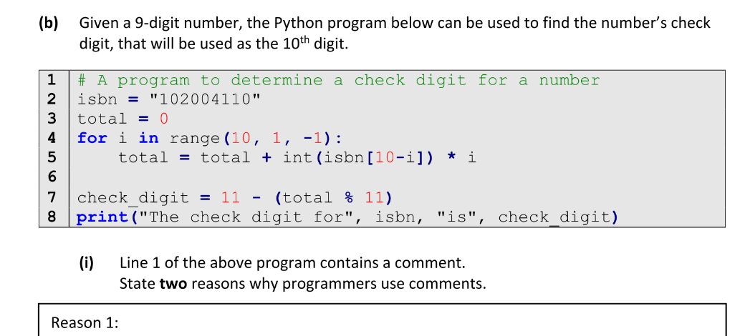
Algorithms – Leaving Cert Questions - Higher

Slide 36
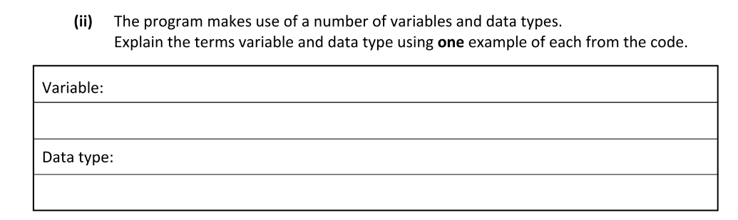

Algorithms – Leaving Cert Questions - Higher

Slide 37
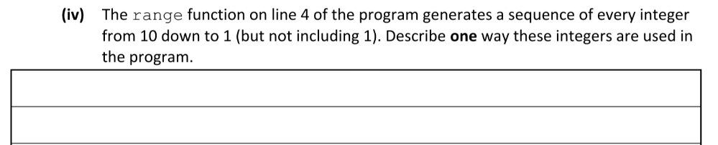
Algorithms – Leaving Cert Questions - Higher

Slide 38
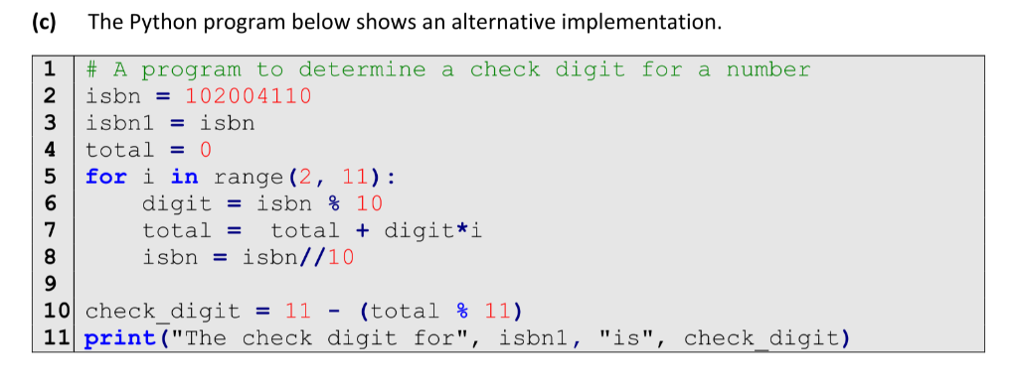
Algorithms – Leaving Cert Questions - Higher

Slide 39
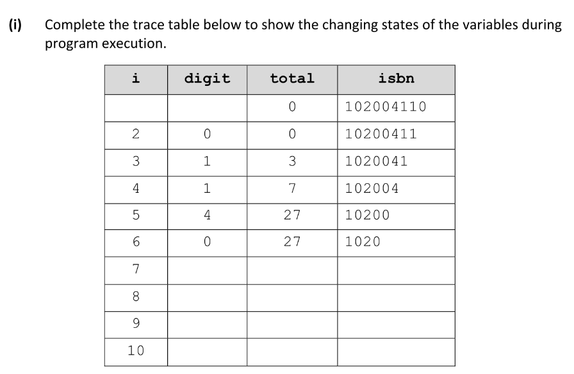
Algorithms – Leaving Cert Questions - Higher

Slide 40

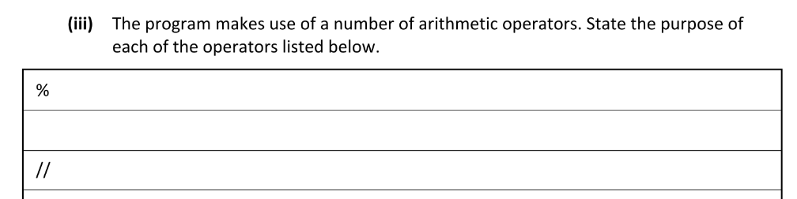
Algorithms – Leaving Cert Questions - Higher

Slide 41
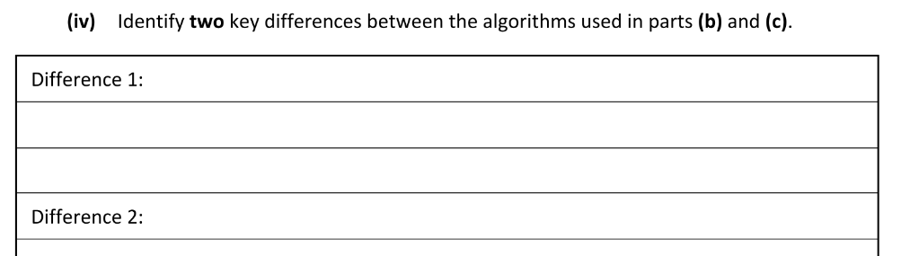
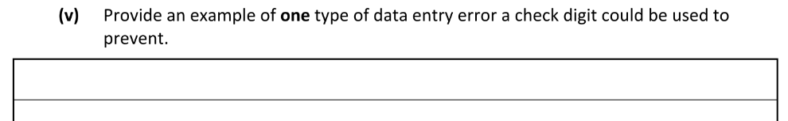
Algorithms – Leaving Cert Questions - Higher

Slide 42
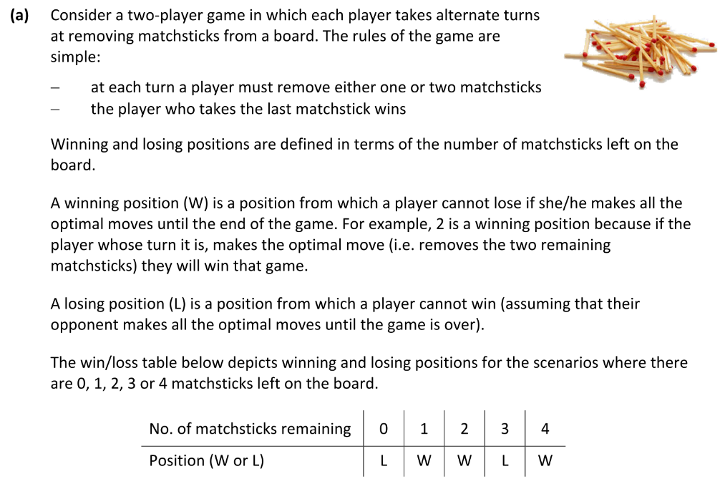
Algorithms – Leaving Cert Questions

Slide 43
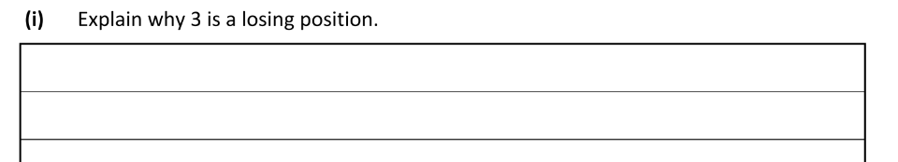
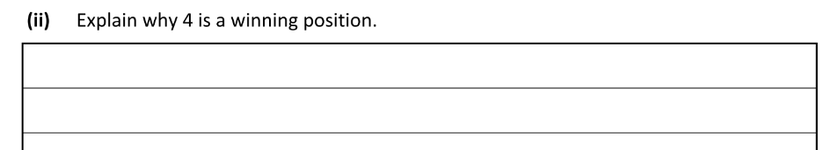
Algorithms – Leaving Cert Questions

Slide 44
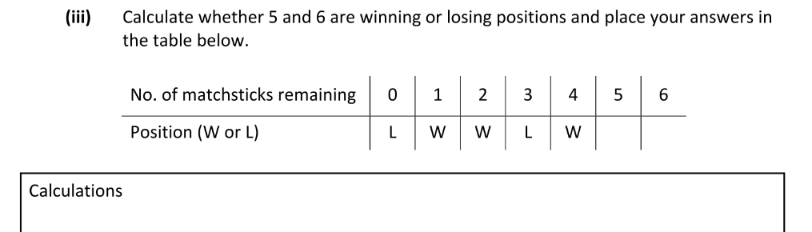
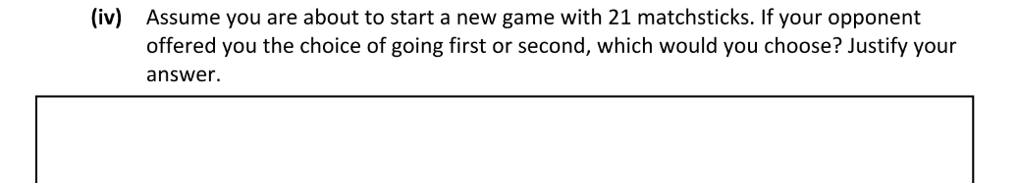
Algorithms – Leaving Cert Questions

Slide 45
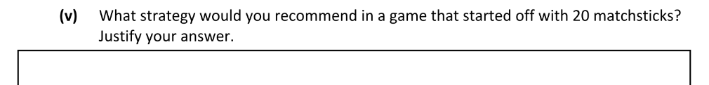
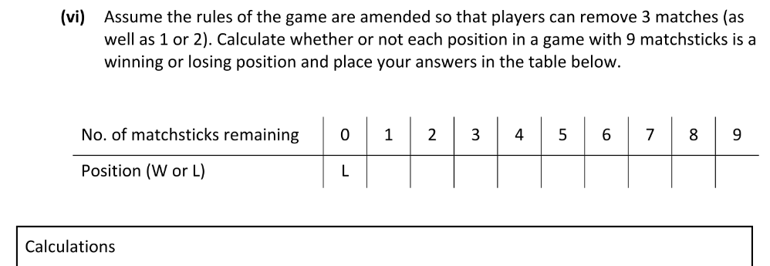
Algorithms – Leaving Cert Questions

Slide 46
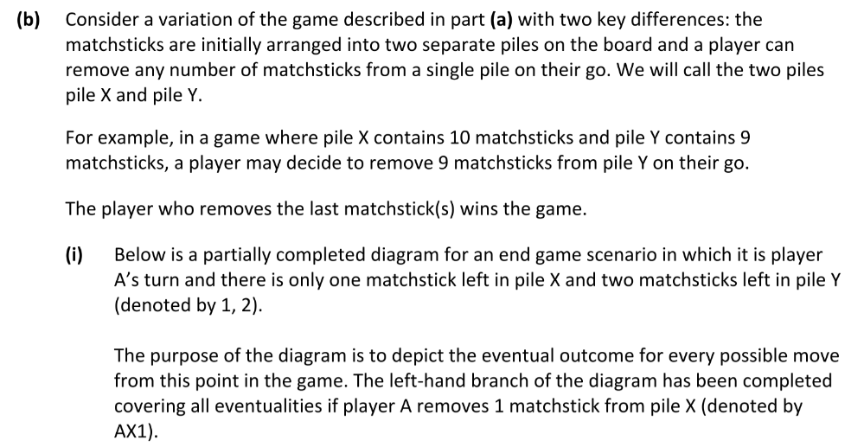
Algorithms – Leaving Cert Questions

Slide 47
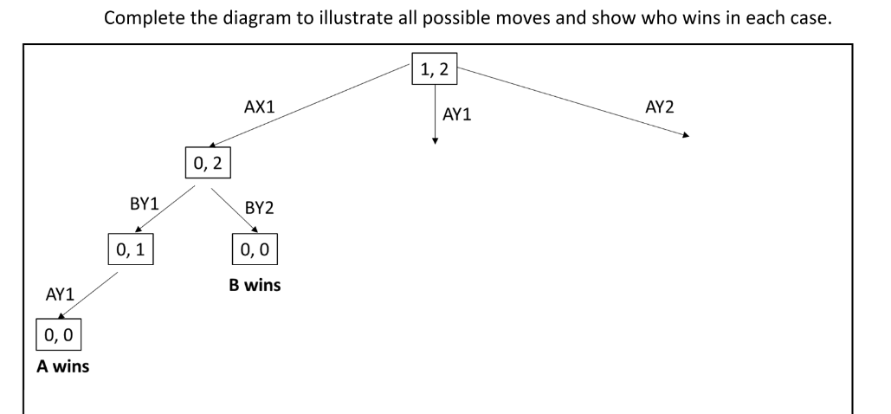
Algorithms – Leaving Cert Questions

Slide 48
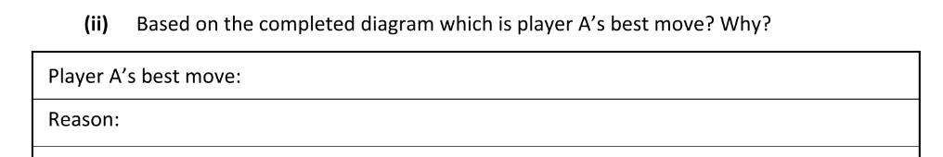

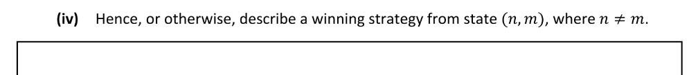
Algorithms – Leaving Cert Questions

Slide 49
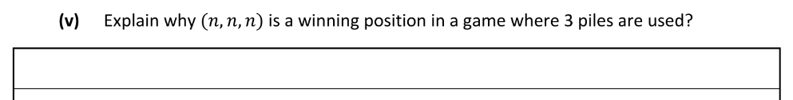
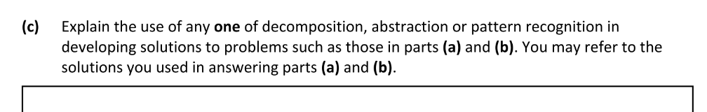
Algorithms – Leaving Cert Questions

